Slide 1
Creating Views in Laravel
Views & BladeTemplating

Slide 5
Views
Views is where we store HTML and lots of contents, we are going to display our user.
So, we have models that interact with database.
We have controllers, which contains lot of our application logic.

Slide 6
Our routes, which contains our applications URL.
Our view, which contains design and HTML that will displayed to user.
In Laravel, all views are store in views folder inside resource folder.
We can create our own folders inside view folder to better organize views.

Slide 7
By default, Laravel provide us welcome.blade.php
View only contains plain HTML(CSS+JavaScript+Bootstrap) + Blade
You always put plain HTML, but have option of adding blade.

Slide 8
Note
Whenever we create a file in view, we always have blade.php at the end.
Example:
welcome.blade.php (welcome is actually name of the file)
about.blade.php
Notes:
HTML ko zaida likhna na paray.

Slide 9
Pages in Views
We create welcome, about, and contact pages in views.
welcome.blade.php, about.blade.php and contact.blade.php
Notes:
HTML ko zaida likhna na paray.

Slide 10
Laravel Layouts with Blade
Blade is templating engine for laravel, it allow us to put PHP inside our HTML code.
Laravel basically translate it and converts it into PHP.
Notes:
HTML ko zaida likhna na paray.

Slide 11
Blade Functions
To organize our views better, we can take advantage of blade functions:
Layouts
Partials
Notes:
HTML ko zaida likhna na paray.

Slide 12
Layouts
Layouts are design through which we can separate repetitive portion of a website.
Example: In a website all of the pages share same navigation. Layouts are design to prevent that, they design to extract code and only have to be one place. From this I will have advantage that whenever I encounter a bug, I will fix it at one time and one place
Notes:
HTML ko zaida likhna na paray.

Slide 13
Layouts
Create a file name main.blade.php inside view. This is where we are going to extract all repetitive elements from all the pages into one single page.
So, in our welcome.blade.php page !Doctype, head, navigation and footer was repetitive, so we put inside main.blade.php
Notes:
HTML ko zaida likhna na paray.

Slide 14
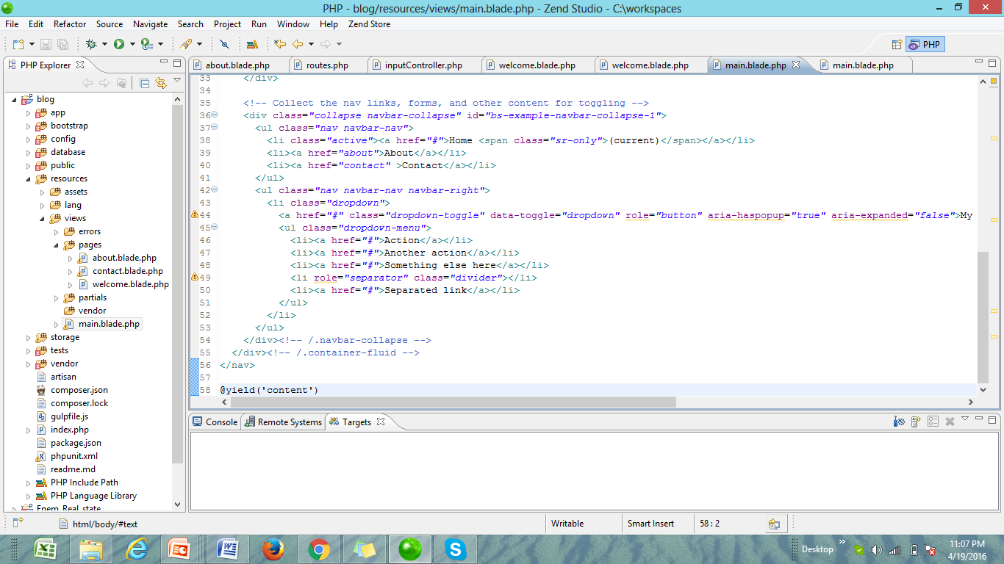

Slide 15
Layouts
Blade start with @ sign. Its signal laravel that we are writing blade not HTML.
@yield(‘content’) this is basically we call a layout, content is the title given to it, so this is container we leave that blank, we dynamically fill that content.

Slide 16
Layouts
Open main.blade.php, add this code @yield(‘content’) this is basically we call a layout.
Now open welcome.blade.php and add these code of blade
@extends(‘main’)
@section(‘content’)
// HTML code of that particular page
@endsection

Slide 17
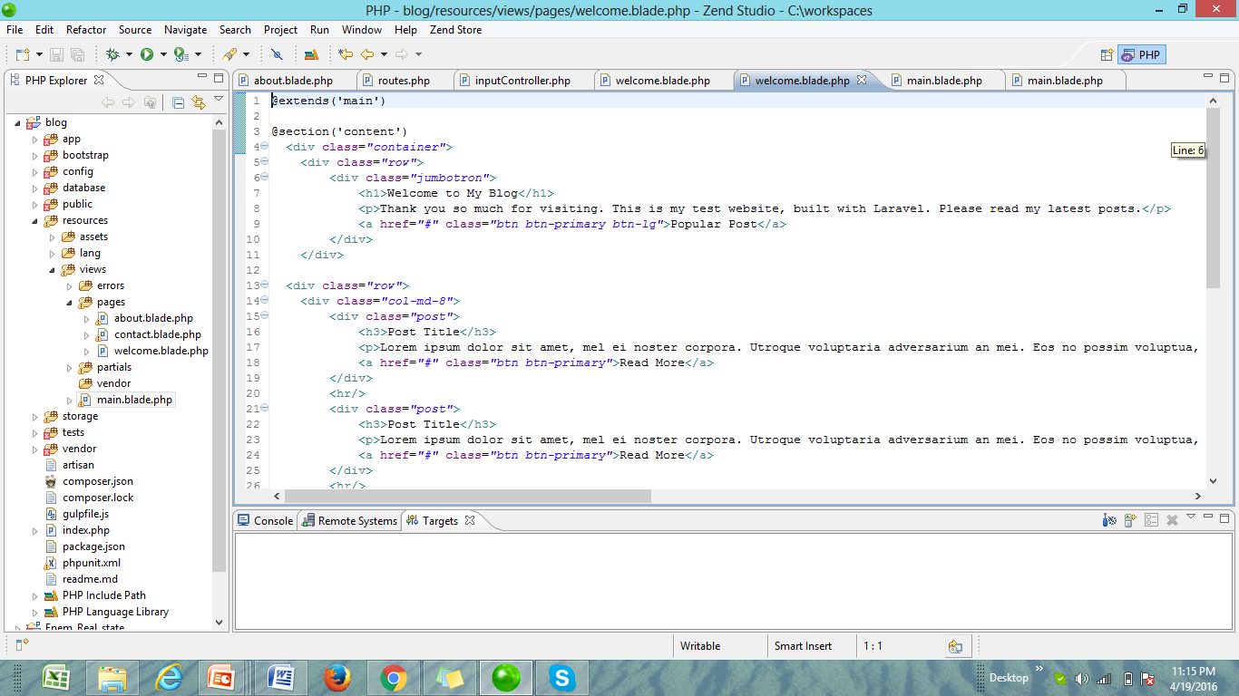

Slide 18
Layouts
You might have specific css file, and you don’t want to load on every single page. What we are going to do, create another section here on welcome.blade.php
@section(‘stylesheets’)
<link rel=“stylesheet” href=“main.css” type=“text/css” />
@endsecion

Slide 19
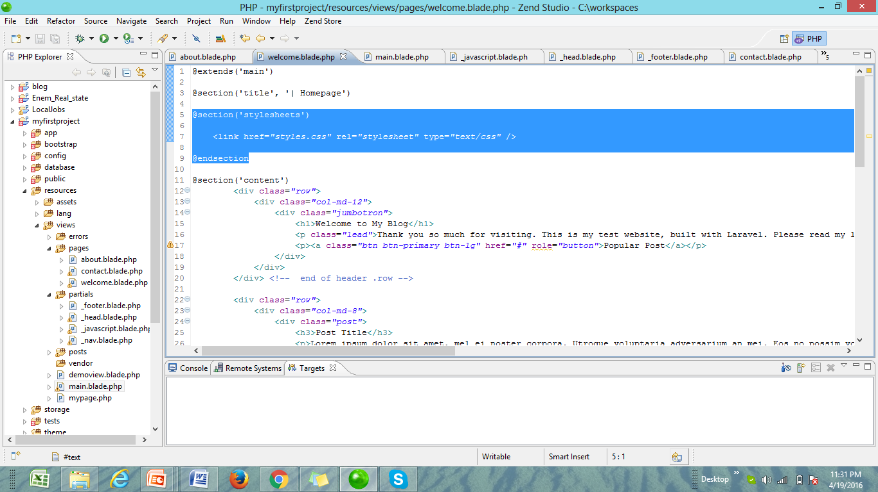

Slide 20
Layouts
You might need to add special JavaScript code or JavaScript file
@section(‘scripts’)
<script src=”js/scripts.js”></script> or
<script>
window.confirm(‘I loaded up some JS’);
</script>
@endsection

Slide 21
Partials
Partial can extract content further, partial can be use for repetitive code and may be its for organizing.
Through partials you can extract code file into its own file.
Example: I can take my navigation, extract that out, and then I know, If I need to work at my navigation. I open up navigation’s partial.
Notes:
HTML ko zaida likhna na paray.

Slide 22
Create Partials
In resource→views create a new folder name partial.
Working with partial, we commonly include _(underscore) before partial name.
Example: _head.blade.php
Open main.blade.php, upto body tag cut every thing and paste in _head.blade.php and in main_blade.php I include this code @include(‘_head’)
Notes:
HTML ko zaida likhna na paray.

Slide 23
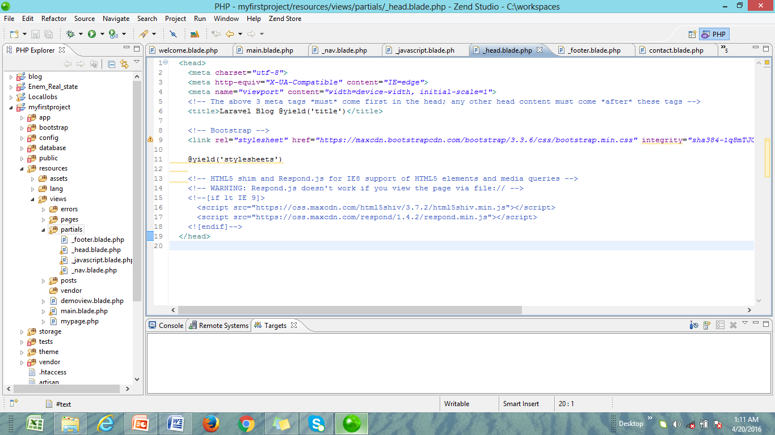

Slide 24
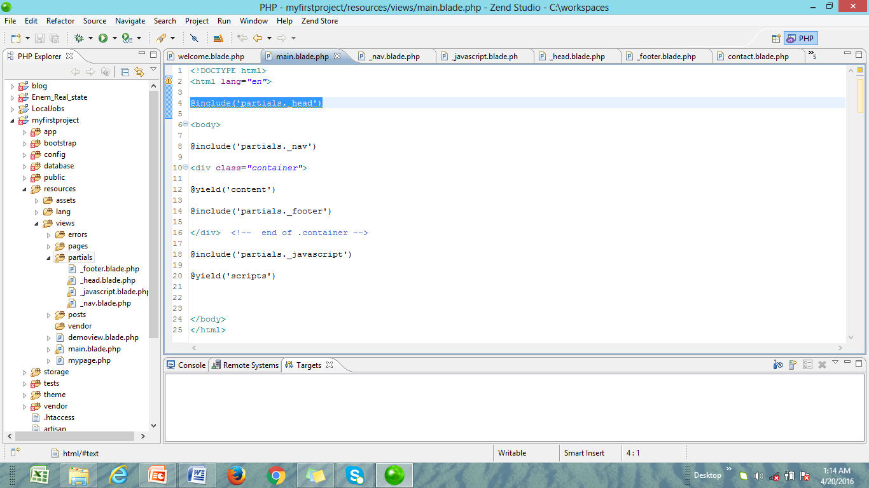

Slide 25
Blade Syntax
PHP Syntax:
<?php foreach($customers as $customer) ?>
Blade syntax:
@foreach($customers as $customer)
@endforeach
Notes:
HTML ko zaida likhna na paray.

Slide 26
PHP Syntax:
<p><?php $customer→cname; ?></p>
Blade Syntax:
<p>{{ $customer→cname }}</p>

Slide 27
Blade Syntax
PHP Syntax
<?php if(true): ?>
<?php echo ‘hello’; ?>
<?php endif; ?>
Blade Syntax
@if(true)
{{ ‘hello’ }}
@endif
Notes:
HTML ko zaida likhna na paray.

Slide 28
Note
So, you can check out lots of these syntax from laravel.com
Notes:
HTML ko zaida likhna na paray.

